Slide 1
Attention Switching: The Magic Middle
erin buchanan

Slide 2
What?
Attention switching:
  Moving your attention around
  Not really your eyes

Slide 3
What?
Attention switching:
  Moving your attention around
  Not really your eyes

Slide 4
How?
Posner’s Beam Theory (1980)
Zoom Lens/Gradient Theories
Open/Close Theory

Slide 5
Beam Theory

Slide 6
Zoom Lens / Gradient Theory

Slide 7
Open / Close Theory

Slide 8
Experiment 1
Based on an experiment by Kwak et al (1991)
  Tested time independent shifts of attention
  Against Posner (same velocity)

Slide 9
Hypotheses
Time independent shifts of attention.
Performance will be affected by objects that appear between target and distractor.

Slide 10
Experiment 1
Same – different matching task
Targets
  T, L
Distractors
  O, T, L
All rotated 0, 90, 180, 270

Slide 11
Trial Types – Visual Angle
L
T
L
T
T
L
2 degrees
4 degrees
6 degrees

Slide 12
Trial Types - Distractors
T
T
T
T
T
L
L
T
O
L
L
No Distractor
Same Distractor
Different Distractor
Neutral Distractor

Slide 13
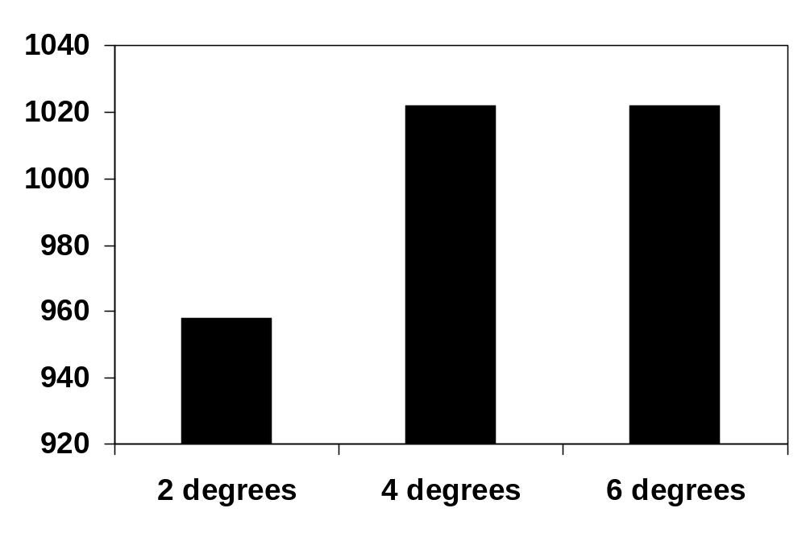
Results - Kwak

Slide 14
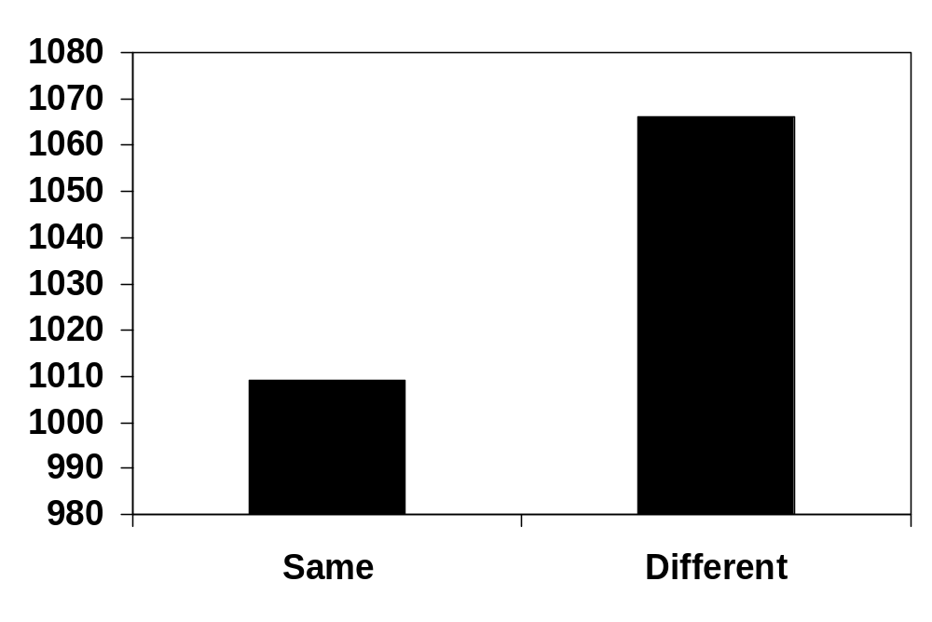
Results - Same / Different

Slide 15
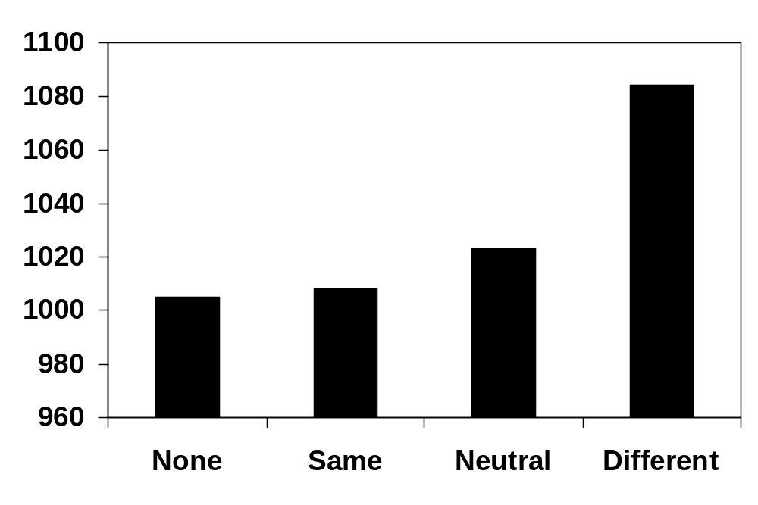
Results - Trial Type

Slide 16
Brief Conclusion
No time independent shifts of attention.
Same decisions are faster that different decisions.
Only the different distractors caused a slowing in deciding same/different.
No facilitation was seen for helpful distractors.

Slide 17
What’s that mean?
Posner’s beam theory is only partially supported.
  Distractors were seen, but only one affected responses.
Open/Close theory cannot be supported.
Zoom/Gradient theory was not tested.

Slide 18
Experiment 2
LaBerge and Brown (1989) replication
  With the same distractor types added

Slide 19
Hypotheses
Performance will be affected by objects that appear between target and distractor.

Slide 20
Experiment 2
Original study
  Signal Detection
  Gradient of attention
New Experiment
  Cued Location
  Distractors

Slide 21
Experiment 2 - Distractors
Look for an “S” then an “O”
Distractor Types
  None
  Same – #O#
  Neutral – #F#
  Different – #C#, #0#
  Reverse

Slide 22
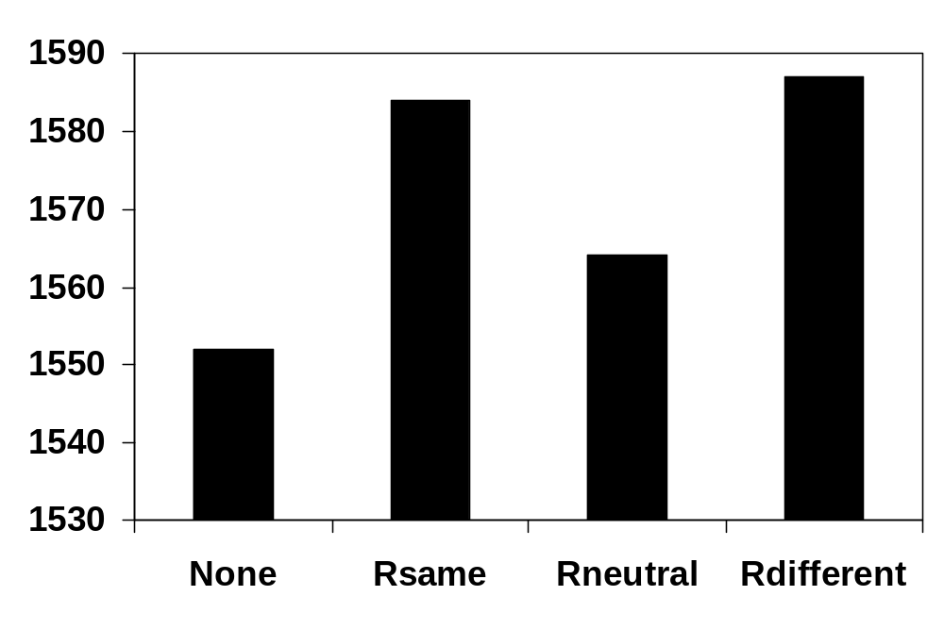
Experiment 2 - Reverse

Slide 23
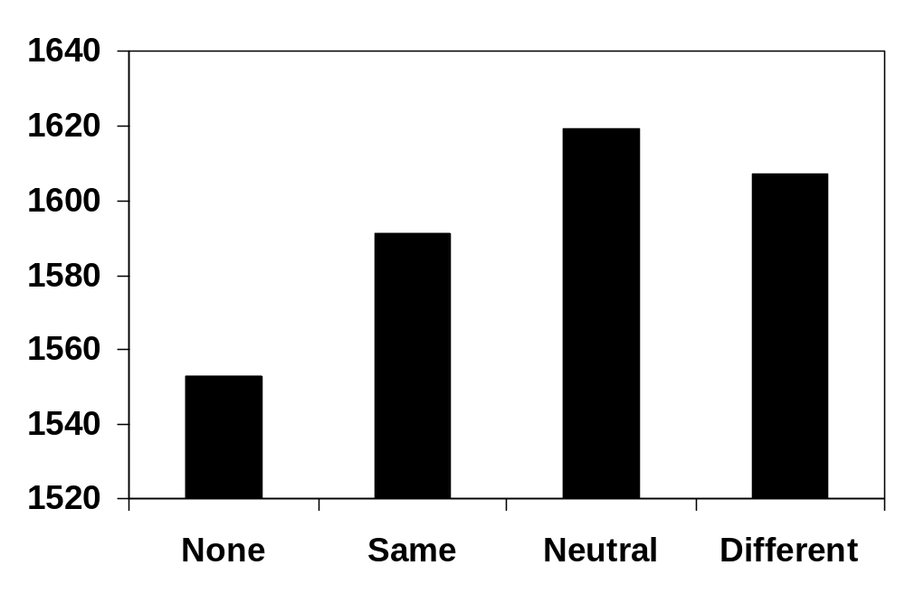
Experiment 2 - Distractors

Slide 24
Problems
Yes/No instead of just Yes?
Analyze hit/miss rates for each distractor?

Slide 25
Brief Conclusions
This experiment may need to be redesigned.
Gradient/Zoom theory may be supported:
  That bad information is in there, but degraded.
  They are ignoring it anyway.

